Slide 1

Capstone Project Phase B 24-1-D-29
Carpool Match, Drive, Share
Supervisor Prof. Zeev Barzily
Submitters
Ben Ben Baruch Ben.Ben.Baruch@e.braude.ac.il Ravid Goldin Ravid.Goldin@e.braude.ac.il
Notes:
Hello everyone. My name is Ben, and this is Ravid. We’ve been working on a project called Carpool, with Zeev Barzily. Today, we will show you the problem we are solving, how our solution works, the structure of the app, and the challenges we faced during the project. So, let’s start.

Slide 2
Outline
Introduction
Problem Definition
Carpool’s Solution
Timeline of a Carpool Ride
Software Architecture
MVC Pattern
Challenges and Solutions
Tests
Video of our application
Notes:
This is what we’ll talk about today. First, we’ll introduce the problem. Then, we will explain the solution we created with Carpool. After that, we’ll show how a carpool ride works, the software architecture, and how we used the MVC pattern. Lastly, we will talk about the challenges and tests we did to make sure the app works well.

Slide 3
Introduction
The Carpool project addresses inefficient public transportation and solo driving issues by offering an innovative mobile application.
Our solution connects drivers traveling regularly to the same destination, creating permanent carpooling groups.
This approach focuses on routine trips, fostering community and trust among participants, ultimately leading to more efficient, sustainable, and enjoyable commuting.
Notes:
Ok so firstly, the application is for drivers only. This is what makes our application different from current apps on market. Our project aims to solve the problems of public transport and reduce solo driving. We created a mobile app that links drivers going to the same place, like work or school, to set up regular carpool groups. This encourages trust and connections between people and makes commuting easier and better for the planet.

Slide 4




Problem Definition
In today's urban environments, the prevalence of solo driving to common destinations like workplaces and educational institutions has led to numerous interconnected issues. This practice not only contributes to increased traffic congestion and higher fuel consumption but also elevates stress levels among commuters. Moreover, it significantly impacts the environment through increased pollution and exacerbates urban congestion problems.
Excessive single-occupancy vehicles
Scarcity of long-term carpooling solutions
Unequal distribution of carpooling costs
Environmental degradation
Notes:
Today, many people drive alone to places like work or college, and this causes problems.
First, too many cars with just one person in them create more traffic and delays.
Second, there aren’t many options for long-term carpooling, so it’s hard for people to share rides over time.
Third, costs aren’t shared equally because it is always the same driver.
Finally, driving alone adds to pollution, so we have environment issues.

Slide 5
Carpool’s Solution
Android and web application which:
Can be implemented for commuters in workplaces or colleges.
Creates permanent carpooling groups based on:
Shared schedules, compatible routes and available seats
Implements Fair Rotation System
Points-based driving allocation ensures equitable participation
Fixed locations displayed on in-app map for convenience
Builds trust and reliability among regular commuters
Notes:
Carpool is an app that can be used on both mobile and web. It can be implemented for drivers in workplaces or colleges. It creates permanent carpool groups based on people’s schedules and routes. It has a points system to make sure everyone takes turns driving. The app also shows fixed meeting points on a map, which makes planning easier. By riding together, people build trust, and carpooling becomes easy.

Slide 6
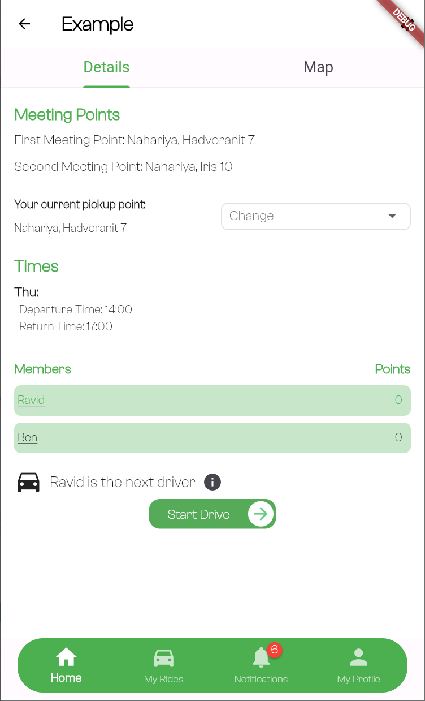
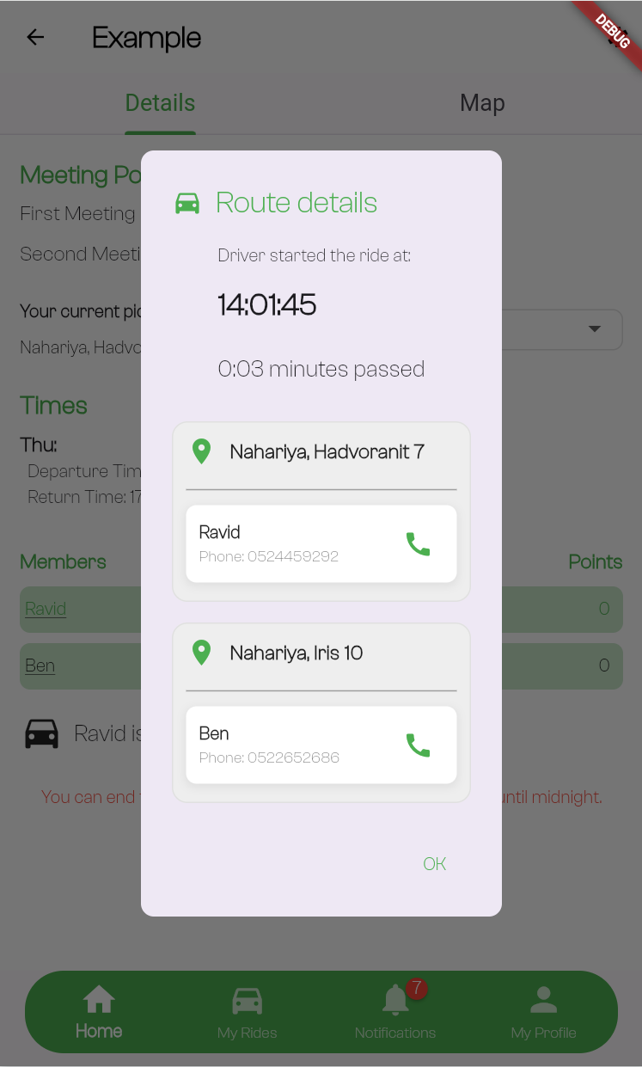
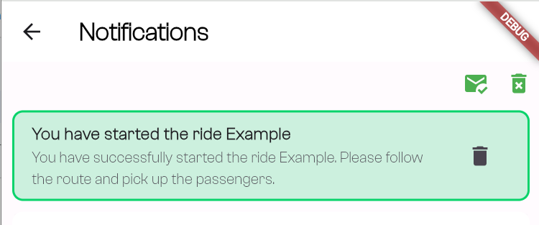
Timeline of a Carpool Ride
14:00 PM
14:01 PM
14:01 PM
Departure time
The driver and other group members receive a notification about the start of the ride
Window that pops up after the ride starts and showing all pickup points details
Opened only to the current driver
Can start drive 15 minutes before the departure time
Pickup point: Nahariya, Iiris 10
User to pickup: Ben
Notes:
Here is how a carpool ride works with Carpool. At 14:00 PM, the driver can start the ride. The button is opened just to the driver. The ride can start up to 15 minutes before the set time, and after a click there is a popup that shows all pickup points. Once the ride starts, both the driver and the group members get notifications, so everyone knows when the ride is happening.

Slide 7
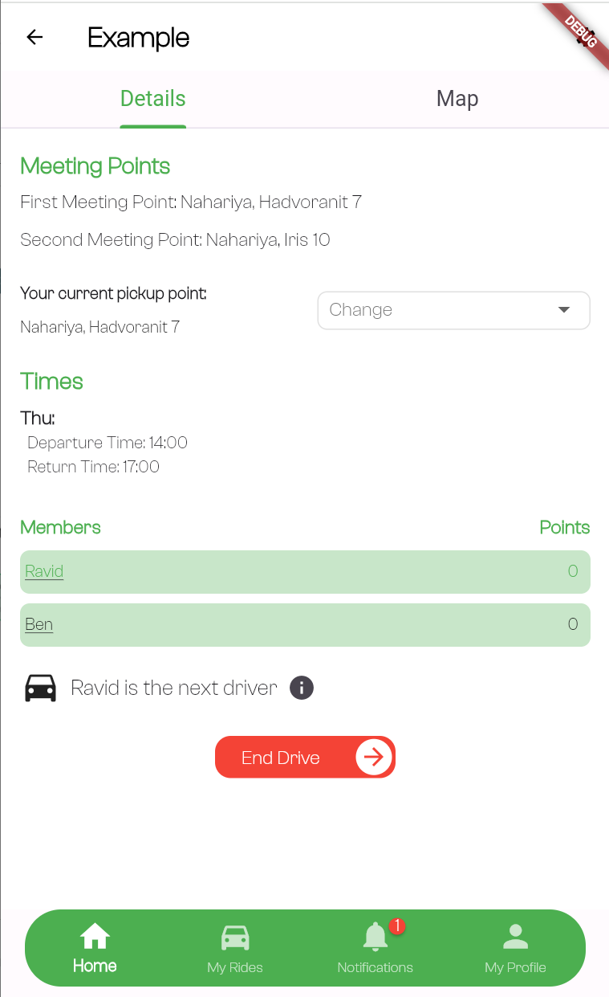
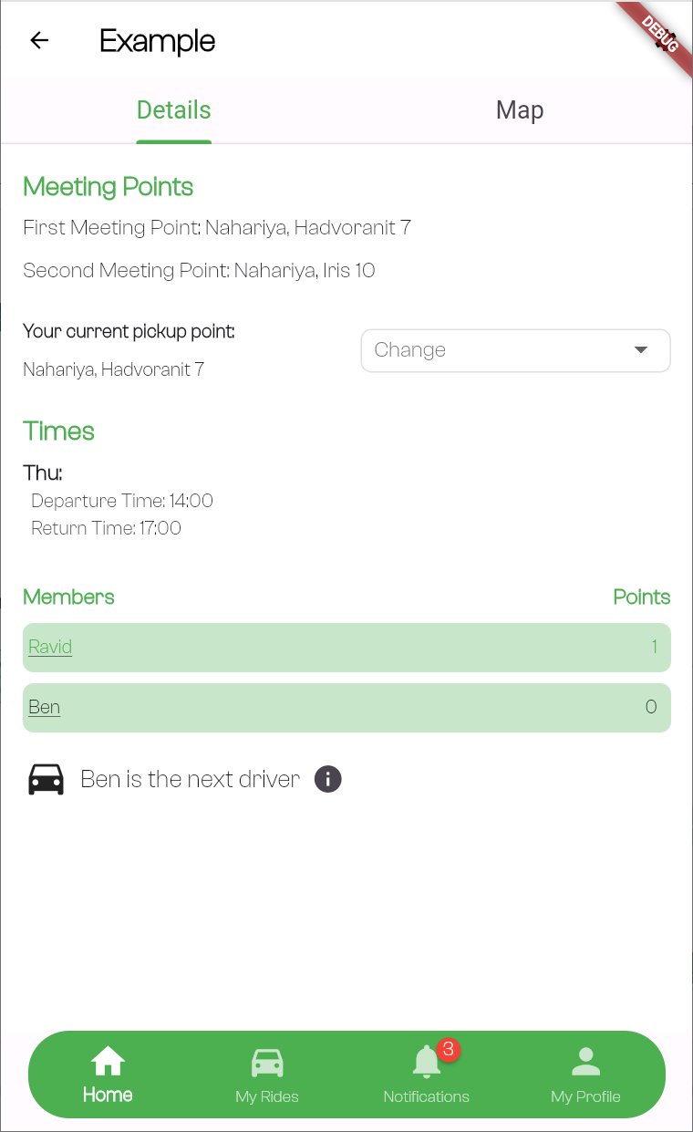

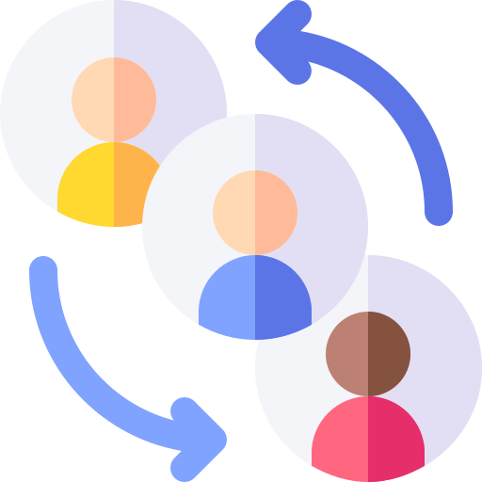
Timeline of a Carpool Ride
17:00 PM
17:01 PM
The driver received a point for his ride.
Can end drive from 10 minutes before the return time
Assigned new driver for next ride automatically
Notes:
At 17:00 PM, the driver can click “End drive”, the button appears starting 10 minutes before the return time. The app assigns a new driver for the next ride automatically. The driver receives a point for completing the ride. This ensures that the process is fair and smooth for everyone involved.

Slide 8
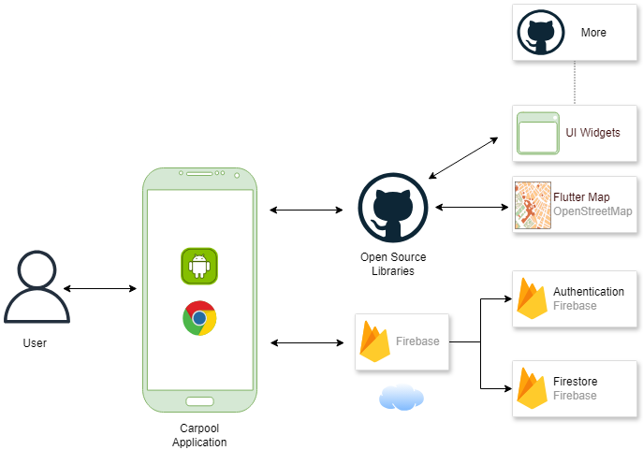
Software Architecture
Users interact with the Carpool app by creating or joining groups, choosing meeting points, and viewing routes. Actions are bi-directional, with real-time feedback.
The app manages user requests, data, and interactions with external services, processing inputs and handling business logic to ensure a seamless experience.
Firebase supports backend services like real-time updates and authentication, managing user data, group details, and notifications to keep users informed.
OpenStreetMap provides accurate, interactive maps for routes, meeting points, and stations, ensuring smooth navigation.
Notes:
There are more open sources library, for different functionality. No place in the slide so say it in presentation. For example, the loading spinner widget or other widgets.

Slide 9
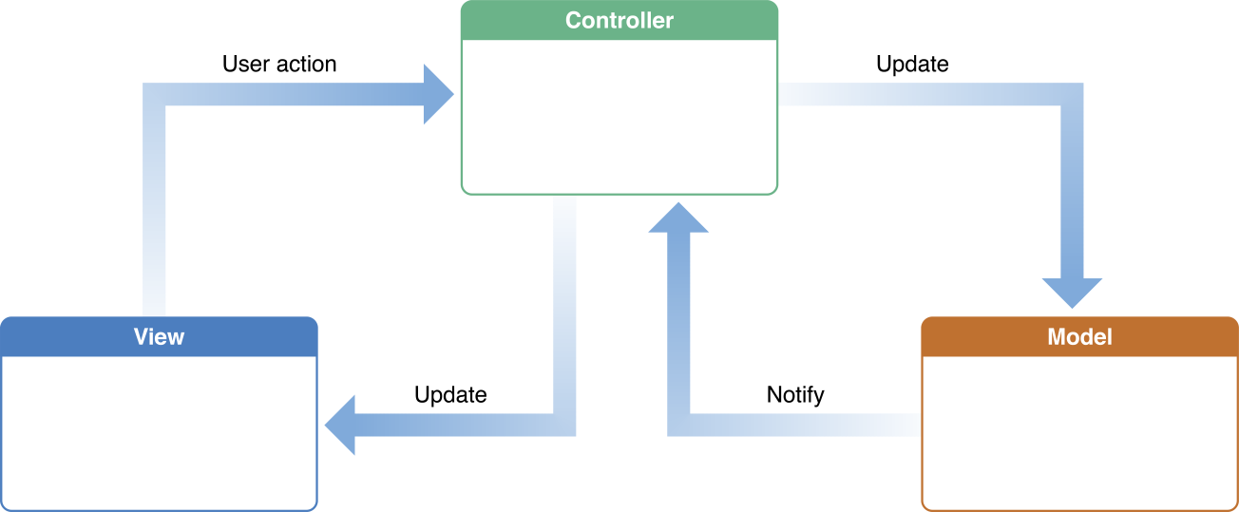
MVC Pattern
Model–view–controller (MVC) is a software design pattern commonly used for developing user interfaces that divides the related program logic into three elements:
Model: Manages application data, logic, and rules, independent of the user interface.
View: Displays data in different formats, allowing multiple representations of the same information.
Controller: Handles input and updates the model or view accordingly.

Slide 10
Challenges and Solutions
Architecture Implementation (MVC)
Challenge: Ensuring clear separation of concerns between Model, View, and Controller while maintaining app responsiveness and modularity.
Solution: Clearly defined roles for each layer (Model, View, Controller), focusing on minimizing dependencies to enhance maintainability and scalability.
Map Integration
Challenge: Integrating a reliable, cost-effective map service, with initial issues in Flutter support for Mapbox and cost constraints for Google Maps.
Solution: Implemented OpenStreetMap using Flutter packages (flutter_map, latlong2, geocoding), providing accurate location services while adhering to project budget constraints.
UI Experience
Challenge: Designing a user-friendly interface that presents complex information (rides, groups, routes) while remaining simple for diverse users.
Solution: Adopted an iterative design approach with user testing, improving features like group creation, route displays, and overall navigation, resulting in higher user engagement and satisfaction.
Notes:
UI experience
Challenge: Designing an intuitive user interface.
Solution: We asked friends and family to use the app on different devices and provide us with feedback.
אופציה נוספת:
Database Structure
Challenge: Designing an efficient Firebase database structure that minimizes operations while handling complex relationships between users, groups, and rides.
Solution: Used a well-planned database structure with collections and sub-collections, utilizing denormalization techniques to optimize performance and support scalable data retrieval.

Slide 11
Tests
During the development of the Carpool application, we conducted manual acceptance testing to ensure the app met specified requirements and was ready for users. This process involved verifying navigation, functionality, and overall user experience against predefined criteria for each feature.
Manual Testing Strategy: Started by testing screen layouts and navigation to verify structure and user flow.
Feature Testing: Manually tested major features like user authentication, group management, ride scheduling, searching and creating groups, and map integration after each development stage.
Real-World Scenarios: Focused on testing the points-based system and simulating real usage patterns to ensure functionality and user experience.

Slide 12

Thank you for listening!
Do you have any questions?

